Slide 1

Control Theory: Challenge Assessment 6
Rebecca Foster
Notes:
Hello friends, my name is Rebecca and today I will be discussing the challenge assessment 6 for control theory.

Slide 2
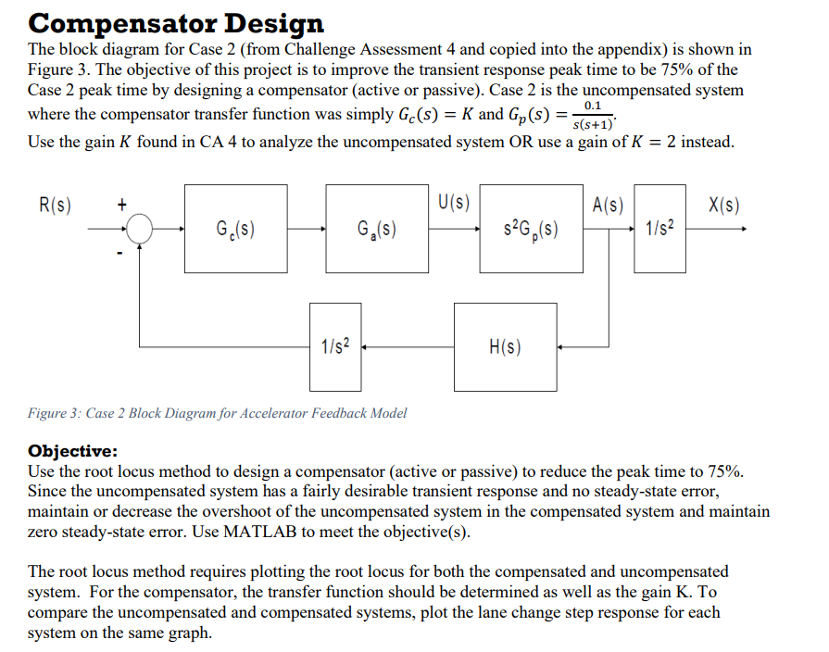
The Problem
Notes:
For this assessment, we are taking the lane change maneuver from challenge assessment four and improving the transient response peak time by 75%. This is a type 1 system, meaning there is one pole at the origin.

Slide 3
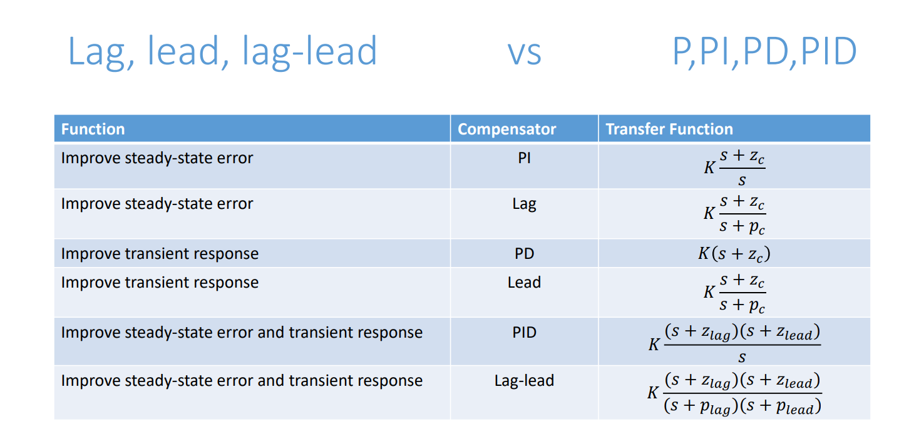
Compensators
Notes:
These are our choices of compensators to improve the system. Our goal is to improve the transient response, so our choices are PD, Lead, PID, and Lag-lead. In this project I decided to do a PD compensator. Since we already have zero steady state error, it makes the redesign much simpler. In addition, PD is an active compensator and therefore there is less noise and can help keep steady state error the same. We assume second order approximation, because later one we find the poles and we now that the two sets of poles are far enough away from each other.

Slide 4
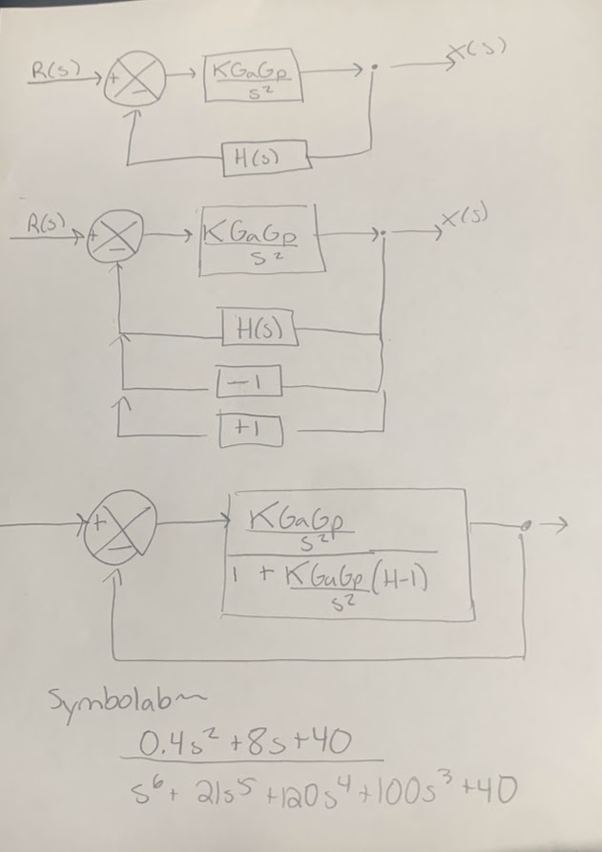
Calculating SSE
Notes:
So to calculate steady state error, you need to use the open loop transfer function. However, there is a catch as to use this the H value in the standard block diagram needs to be one. To get around this here, we add two more feed back loops. We add a one, which is what we want our feedbac to be, and then a negative one because if we add a one we need something to cancel it out. Then we combine everything into a single block. Using symbolab I got that for the Oopen loop transfer function for steady state error.

Slide 5
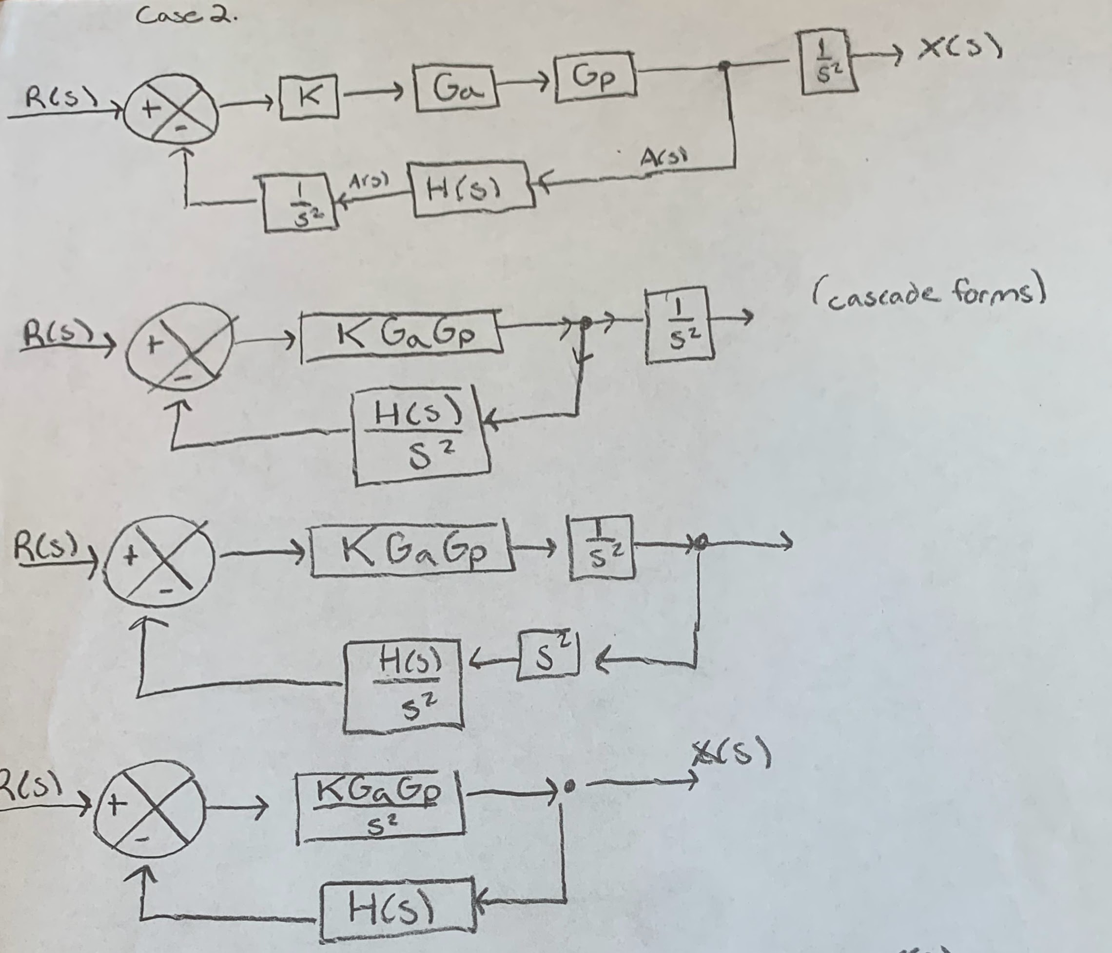
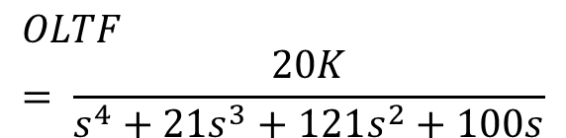
Block Diagram and Transfer Function
$$OLTF= \frac{20K}{s^{4}+{21s}^{3}+121s^{2}+100s}$$
Notes:
So prior to this, this is how I managed the original block diagram to get into standard form to find the regular open loop transfer function, which you can see on the left.

Slide 6
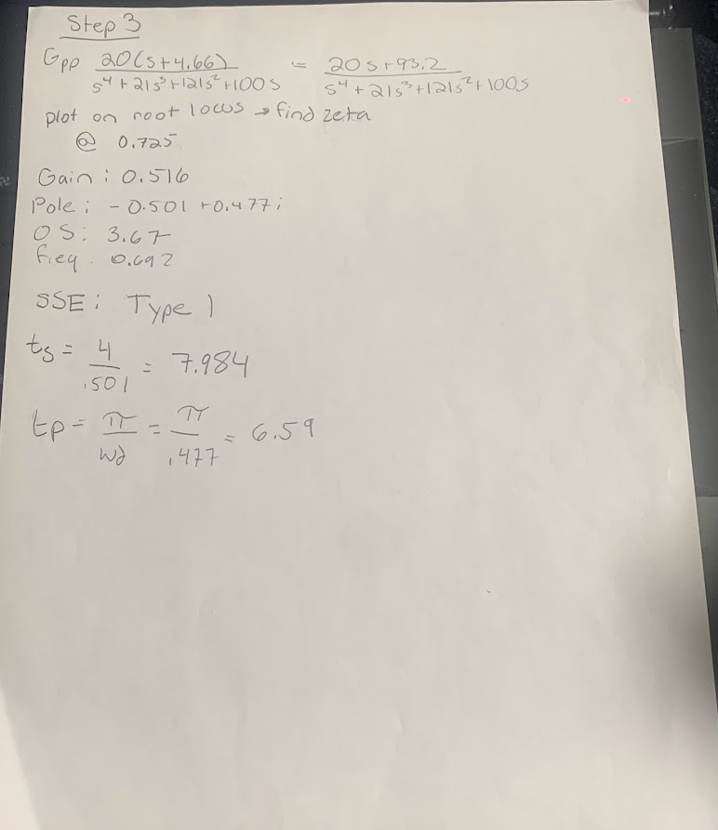
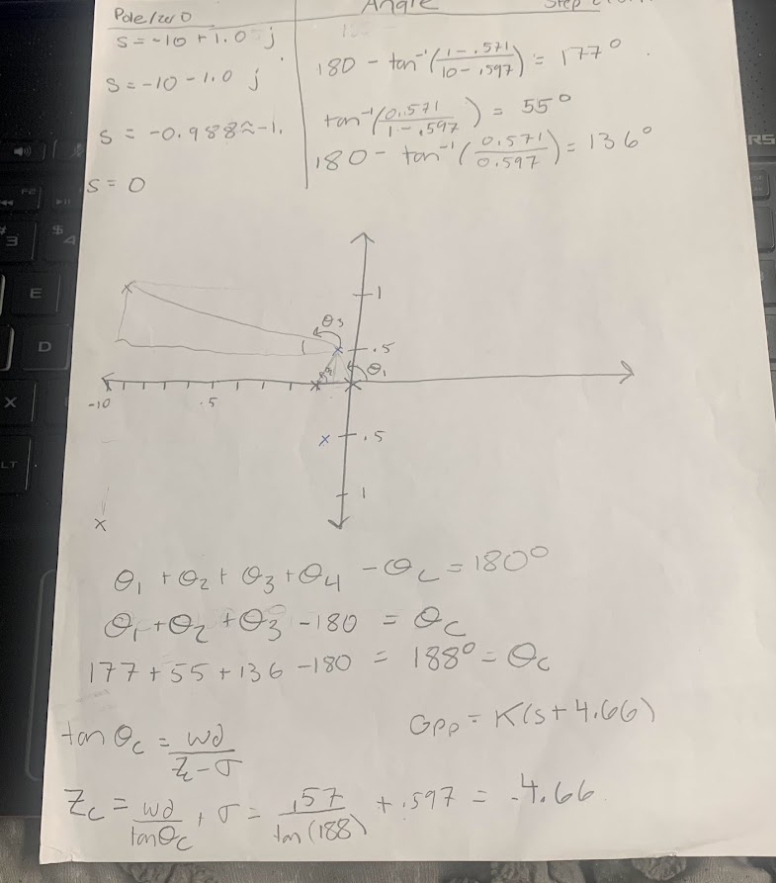
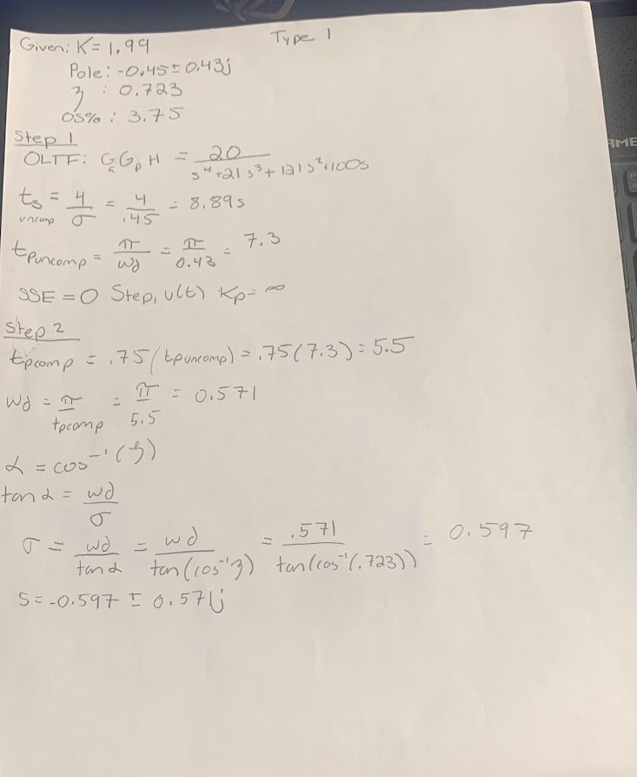
Computations
Notes:
So in all honesty, I really struggled in Matlab so I did this problem out by hand and then went back and did the Matlab. Basically I plotted the original root locus and looked at the gain of two where the dominant pole pairs were. I got all of the information I needed there and computed the transient response performance characteristics. I went to step two and found where the ideal poles would have been. Then I found where the zero pole pair would be and compared to the original design. I will add this onto the blacboard as well.

Slide 7
MatLab Code
% CA 6
%Uncompensated design
%Step 1
num2 = 20;
den2 = [1, 21, 121, 100, 0];
sys2= tf(num2, den2);
T2 = feedback(sys2,1);
poles2 = pole(T2);
Kp2 = dcgain(sys2);
ess2 = 1/(1+Kp2);
figure(1);
rlocus(sys2);
TsUncomp = 4/0.45; %Pulled the denominator from the pole location
TpUncomp = pi/0.43; %Pulled the denominator from the pole location
Zeta = 0.723; %From root locus plot
%Step
TpComp1 = 0.75 * TpUncomp; %Desired Peak Time
Wd = 3.14159/TpComp1; %Desired imaginary pole location
Alpha = acosd(Zeta);
X = tand(Alpha);
Sigma = Wd/X; %Desired real pole location
TsComp1 = 4/Sigma;
%Angle Contributions
Pole1 = 180 - atand((1-0.571)/(10 -.597)); %Angle contribution for complex
Pole2 = atand(0.571/(1-.597)); %Angle contribution at s = -1
Pole3 = 180 - atand(0.571/.597);
ThetaC = Pole1 + Pole2 + Pole3 - 180;
Zc = (Wd/(tand(ThetaC))) + Sigma;
%Step 3
num3 = [20, 93.2];
den3 = [1, 21, 121, 100, 0];
sys3 = tf(num3,den3);
figure(2);
rlocus(sys3);
Kcomp = .726; %Found on root locus plot
T3 = feedback(sys3, 1);
poles3 = pole(T3);
Kp3 = dcgain(sys3);
ess3 = 1/(1+Kp3);
TpComp2 = 3.14159/.8224;
TsComp2 = 4/.8224;
Notes:
This is the matlab code I used to compute my findings. I struggled with it a lot and ended up hard coding some of the information lie sigma and omega d I got from the pole pairs. In the end though I think I got pretty ok results.

Slide 8
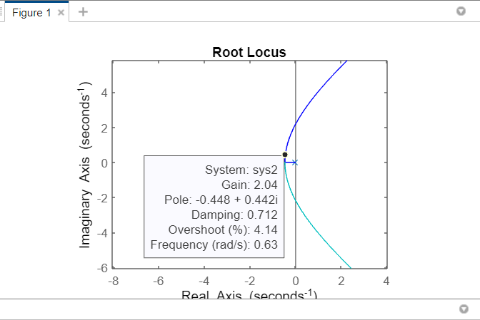
Uncompensated Root Locus
Characteristic | Value
Zeta | 0.723
Peak Time | 7.306 s
Settling Time | 8.889 s
Max Overshoot | 4.14%
SSE | 0
Gain | 2
Notes:
So this is for my uncompensated design. As you can see it has o characteristics such as a zero steady state , but ideally we want to lower the peak time without losing all of the good stuff we have going on for ourselves.

Slide 9
Desired Performance Characteristics
Characteristic | Value
Peak Time | 5.48 s
Settling Time | 6.67 s
Max Overshoot | 4.14% or less
SSE | 0
Desired pole locations: $s=0.60{0 }_{−}^{+} 0.5733$
Notes:
These were the desired performance characteristics, with the peak ime of about 5 and a half seconds. From the calculations I did I determined we would want a sigma of 0.6 and an omega d of about 0.6.

Slide 10

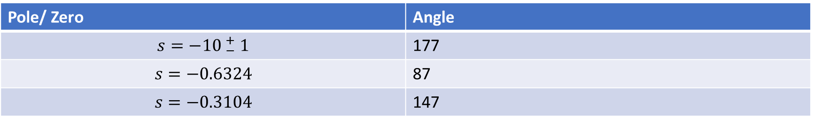
Angle Contribution
Pole/ Zero | Angle
$$s=−1{0 }_{−}^{+} 1$$ | 177
$$s=−0.6324$$ | 87
$$s=−0.3104$$ | 147
$$θ_{c}=177+87+147 −180$$
$$Z_{c}= \frac{ω_{d}}{\tan{θ_{c}}}$$
Add Zero at 1.0736
Notes:
So to find where the compensator zero should be added, I found the angle contributions of the poles. I noticed now that I should have had a pole at zero, and I do in my hand calculations, but since I despise matlab this is what we have going for ourselves. I ended up here finding the zero at one.

Slide 11
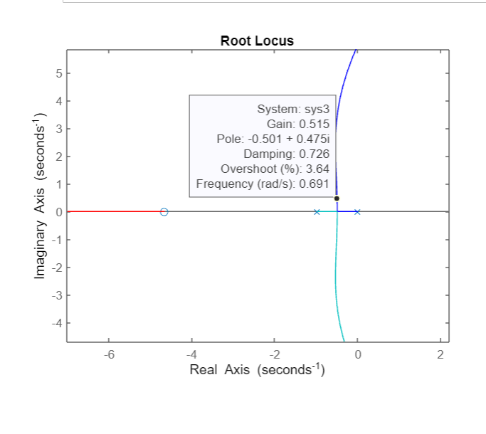
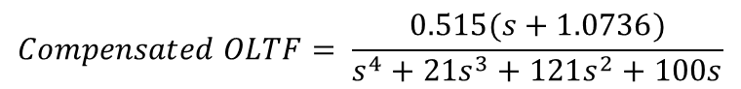
Compensated Root Locus
Characteristic | Value
Zeta | 0.723
Peak Time | 3.82 s
Settling Time | 4.86 s
Max Overshoot | 3.64%
SSE | 0
Gain | 0.515
$$Compensated OLTF= \frac{0.515(s+1.0736)}{s^{4}+{21s}^{3}+121s^{2}+100s}$$
Notes:
This is our compensated open loop transfer function. We added a zero and using zeta I found the gain and other necessary info to compute the peak time and max overshoot.

Slide 12
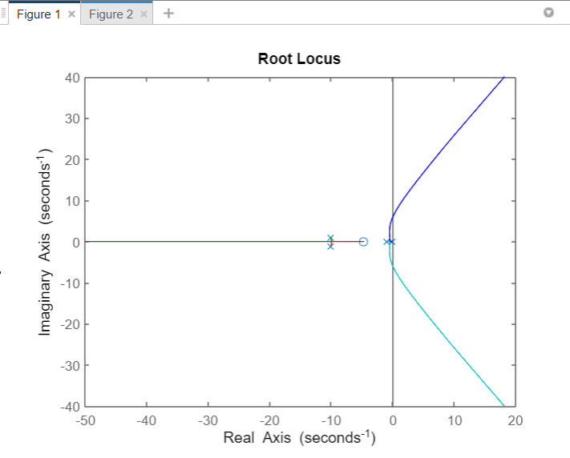
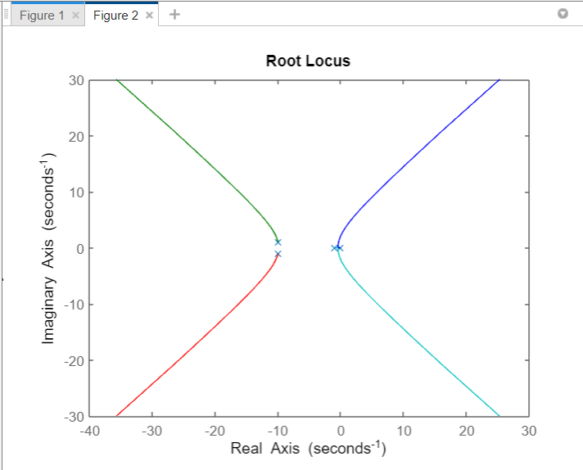
Summary
Characteristics | Uncompensated | Desired | Compensated
Zeta | 0.723 | 0.723 | 0.723
Peak Time | 7.306 s | 5.48 s | 3.82 s
Settling Time | 8.889 s | 6.67 s | 4.86
Max Overshoot | 4.14% | 4.14% or less | 3.64%
SSE | 0 | 0 | 0
Gain | 2 |  | 0.515
Notes:
So this is our comparison of the uncompensated and compensated root locus. As you can see we significantly reduce the peak time the system takes in addition to the settling time. We also decreased the overshoot and determined the gain to be a gain of 0.515. There were differences between the expected and compensated design. This is because we have to take into account angle contributions from the poles we already have. Thank you for your time!

